Slide 1
Dockerize an ASP.NET Core 2.1 Application
Henry He

Slide 2

Bio
Henry He
MCSD with years software design and development experience

Slide 3
Agenda
What is Docker?
Why Docker?
How Docker Works?
ASP.NET Core 2.0 Linux Container
Docker for Windows
ASP.NET Core 2.0 Windows Container
Revamp Dev Process with Docker
Q & A

Slide 4
What is Docker?

Slide 5
What is Docker?
Docker is a tool designed to make it easier to create, deploy, and run applications by using containers.

Slide 6
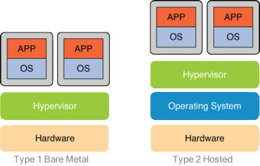
What is Container?
Virtual Machine

Slide 7
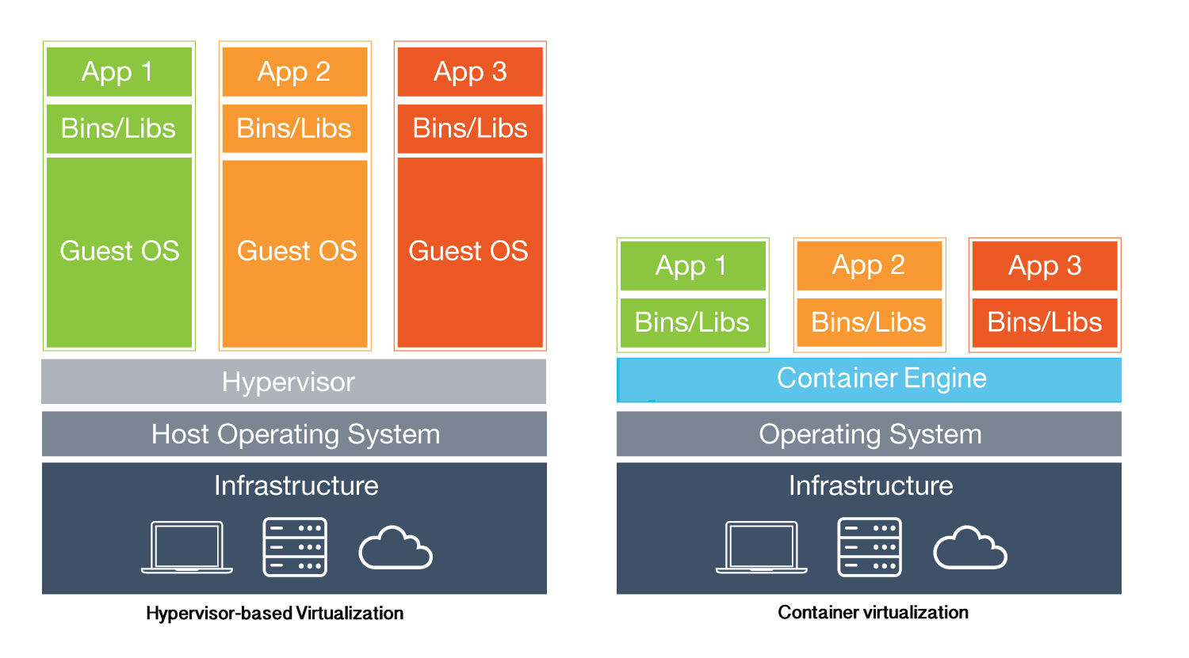
What is Container?
Virtual Machine vs Container

Slide 8
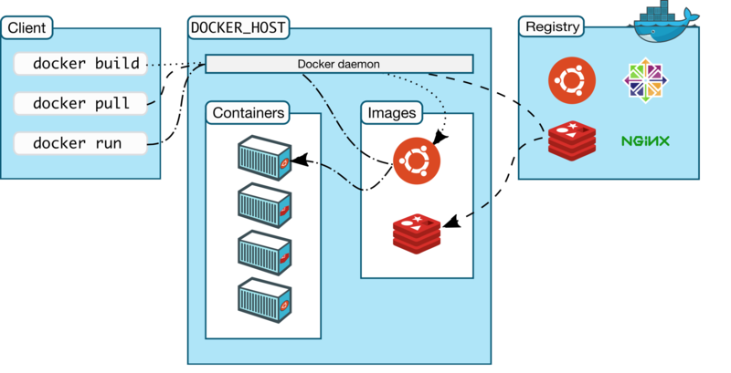
What is Docker?

Slide 9
Why Docker?

Slide 10
Why Docker?

Slide 11
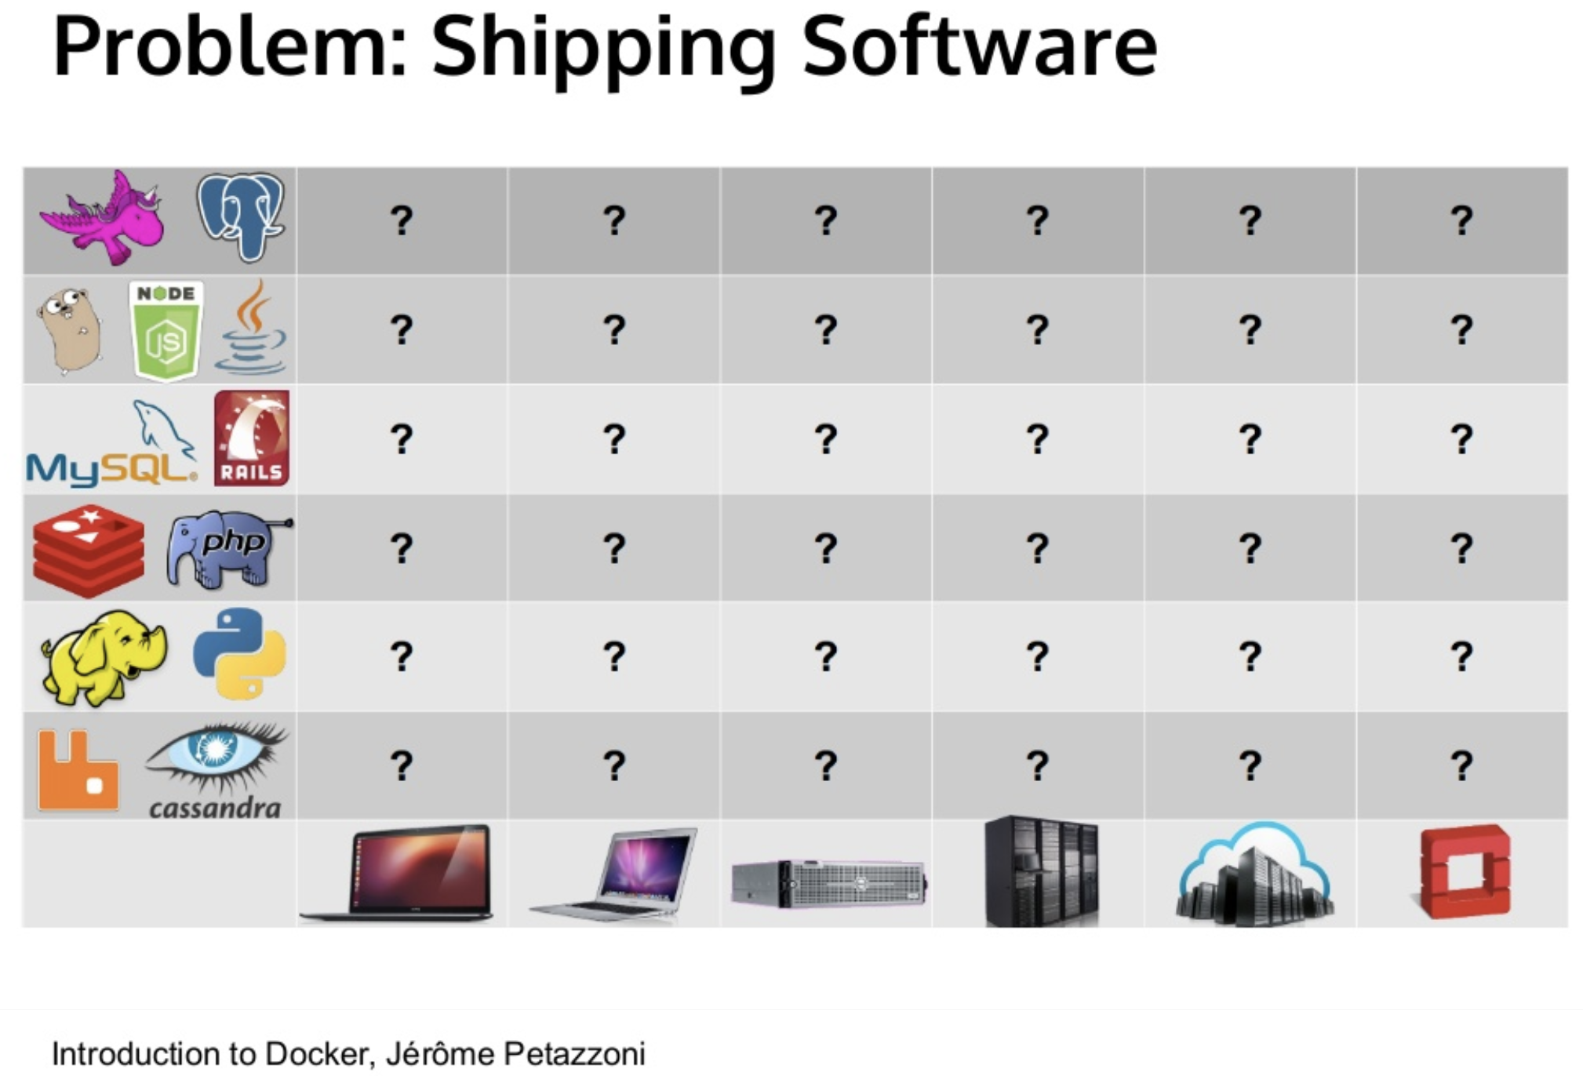
Why Docker?

Slide 12
Why Docker?
Isolation
Modularity
Version Control
Rapid Deployment

Slide 13
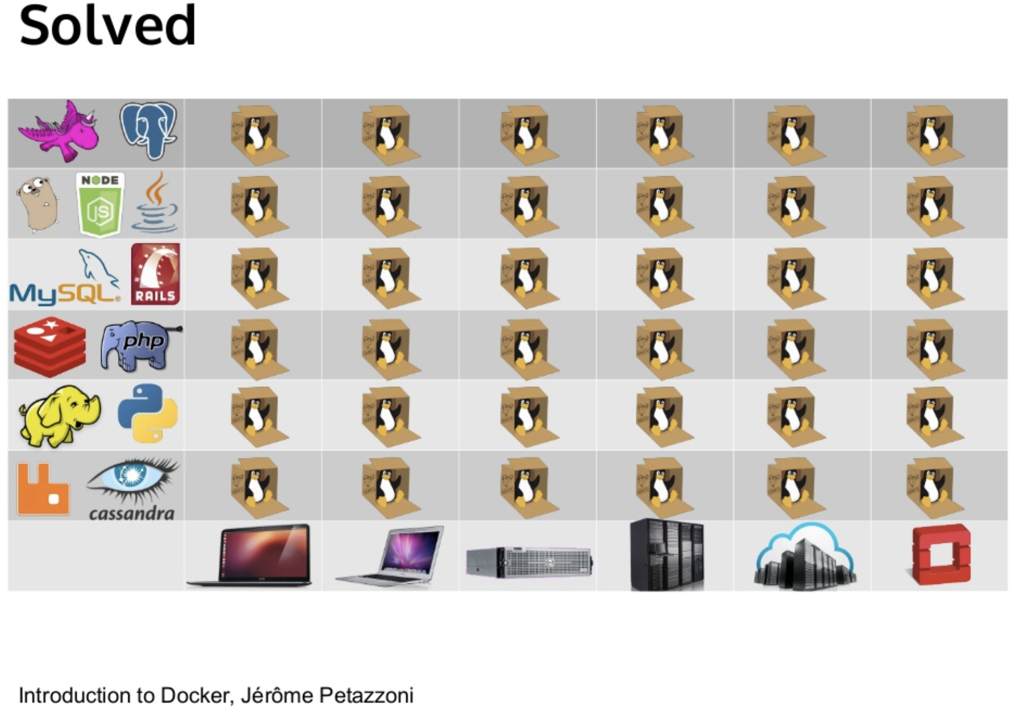
Why Docker

Slide 14
How Docker Works?

Slide 15

How Docker Works?

Slide 16
Docker for Windows?

Slide 17
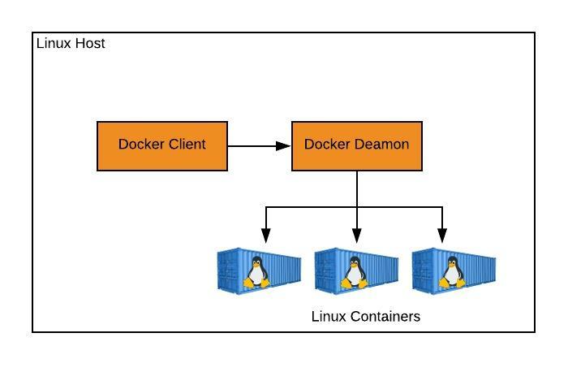
Docker

Slide 18
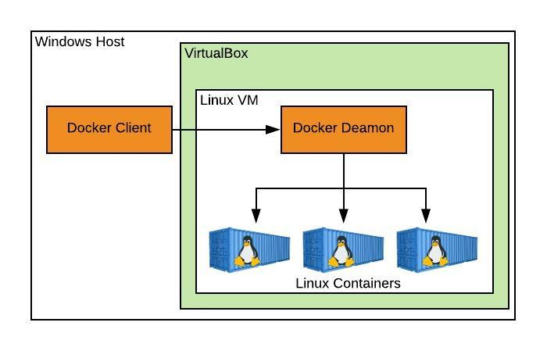
Docker Toolbox

Slide 19
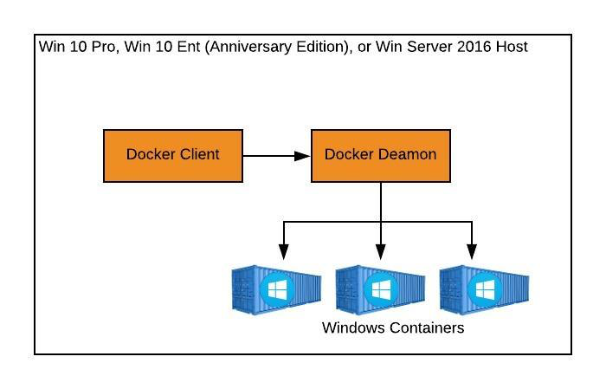
Docker for Windows

Slide 20
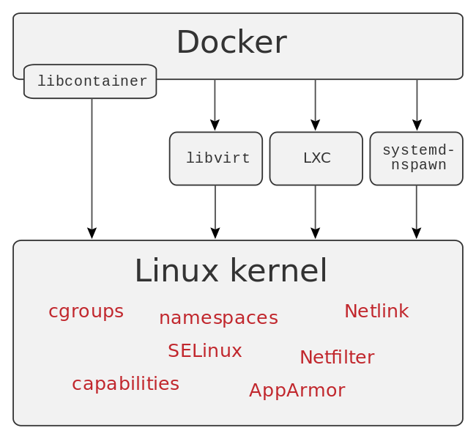
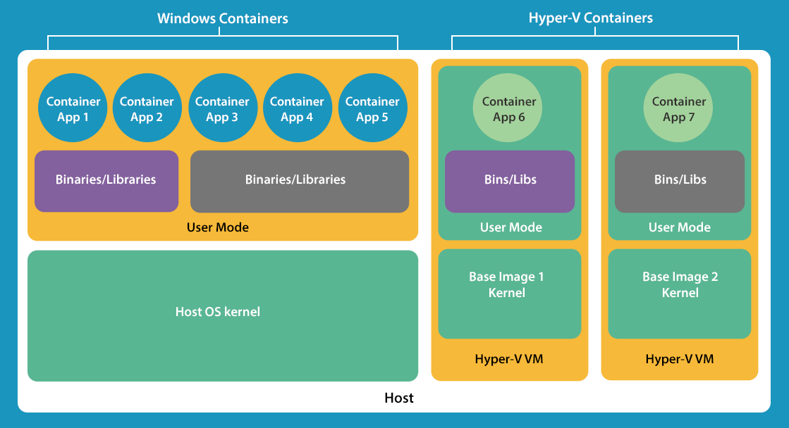
Docker for Windows
Windows Server Container
Hyper-V Container

Slide 21

IS COOL

Slide 22
Revamp Dev Process with Docker

Slide 23
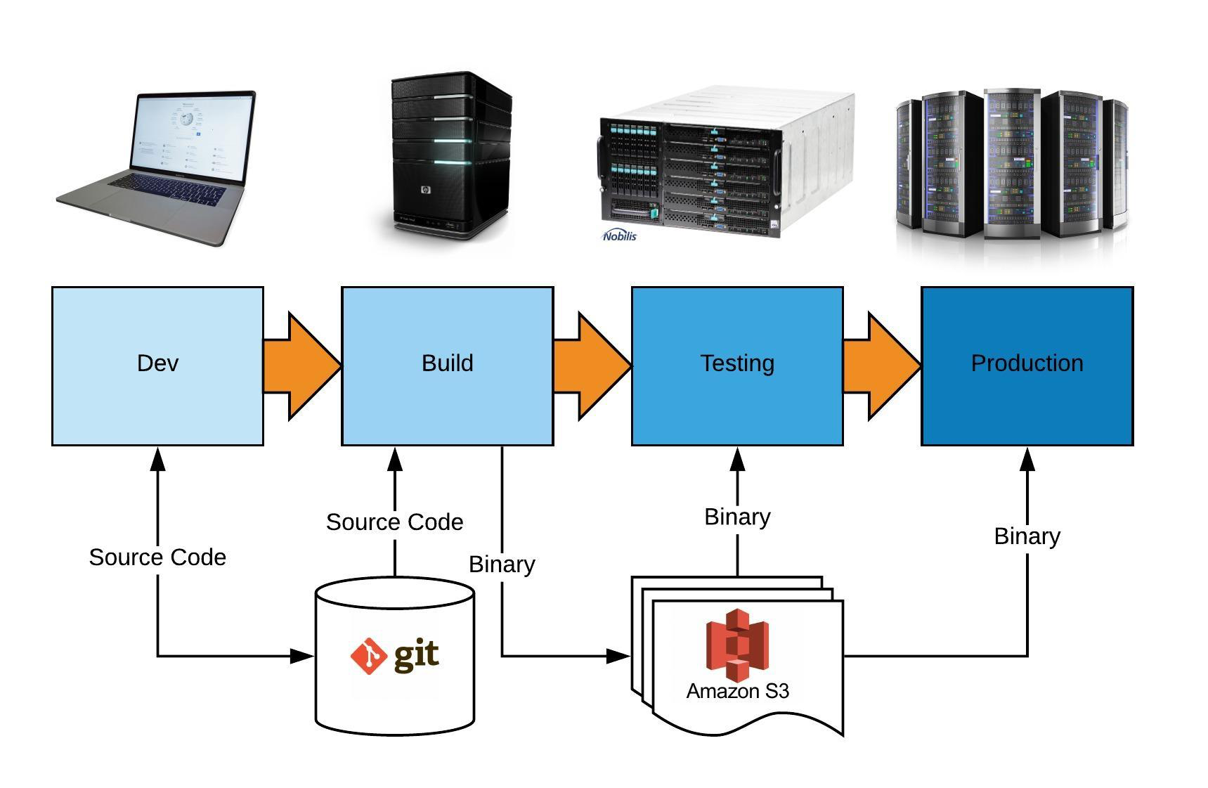
Dev Process

Slide 24
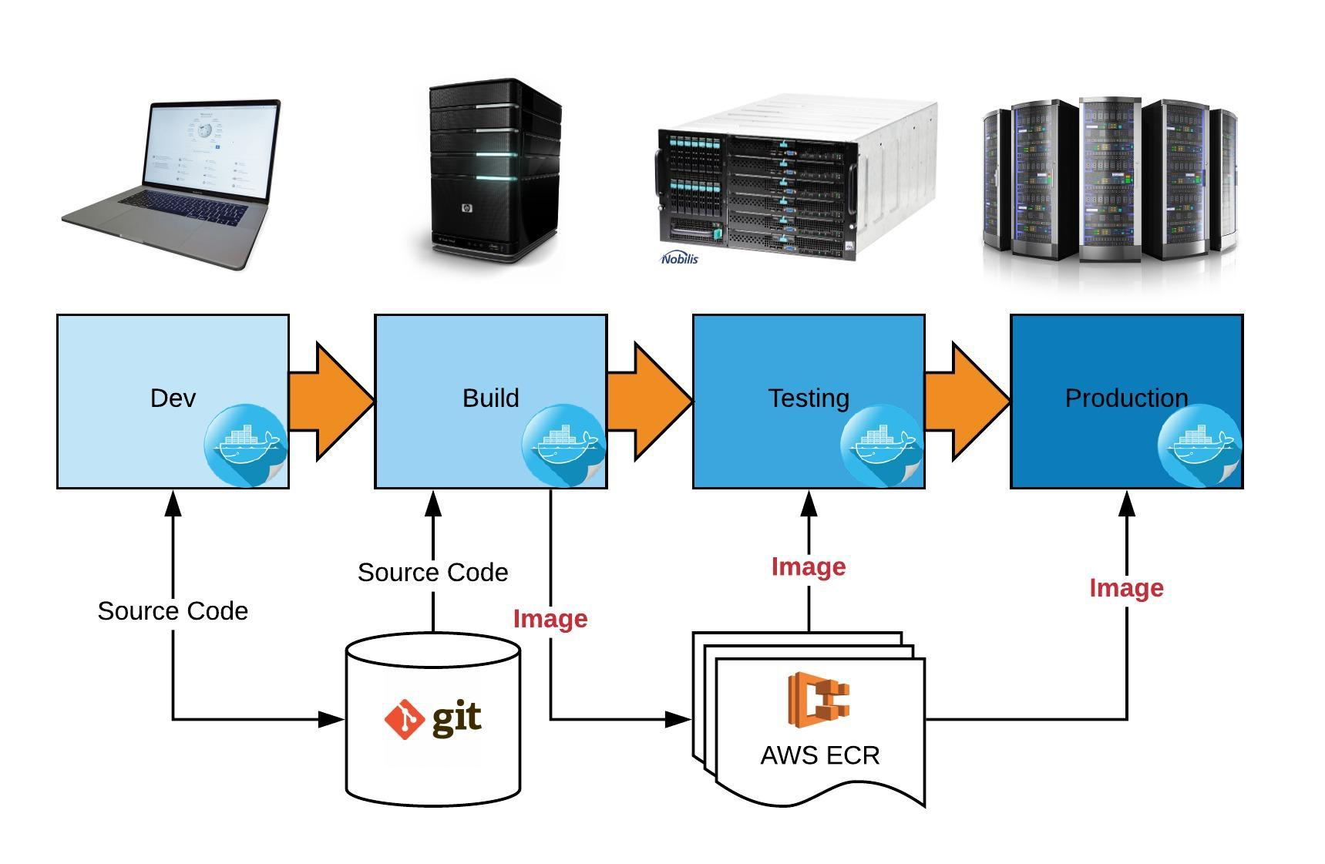
Dev Process with Docker

Slide 25
Summary
“If deploying software is hard, time-consuming, and requires resources from another team, then developers will often build everything into the existing application in order to avoid suffering the new deployment penalty.” ― Karl Matthias, Docker: Up and Running

Slide 26
Q&A
Contact
Email: henryhe9999@gmail.com
Blog: http://henrycomputerworld.blogspot.com/
GitHub: https://github.com/henryhe9999
Twitter: https://twitter.com/henryhe9999

